Slide 1
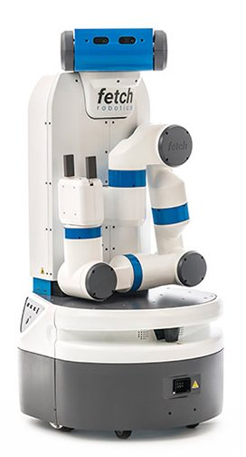
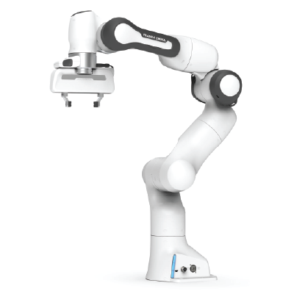

Learning for Interactive Robots Lifelong Robot Library Learning: Bootstrapping Composable and Generalizable Skills for Embodied Control with Language Models
Presenter: Tyler Kim

Slide 2
Overview
Overview of Paper
Background Knowledge
How LRLL works?
Experimental Results
Strengths And Weaknesses
Extensions
Appendix

Slide 3
I. Overview of Paper

Slide 4
Overview of Paper
Authors: Georgios Tziafas and Hamidreza Kasaei
Motivation: LLMs for generating policy code limit agent to stationary range of addressable tasks
Contributions:
Lifelong Robot Library Learning (LRLL): LLM that grows robot skill library
Dynamic storage and retrieval of past experiences to serve as context
Self-guided exploration policy
Distills recent experiences into new skills
Learn new skills with minimal human online interaction
Bypasses
Model finetuning
Gradient-based optimization
Notes:
Motivations
Stationary range of actions
Weak scalability

Slide 5
II. Background Knowledge

Slide 6
II. Background Knowledge
Machine Learning: computer systems that can learn and adapt without being explicitly trained
Finetuning: process of finding the best value for nontrainable parameters
Gradient-based optimization: the use of gradients to optimize an objective function
Large Language Models (LLM): a type of machine learning algorithm that generates natural language and others
Bootstrapping: sampling with replacement
General
Abstract Syntax Tree (AST): a tree representation of code
Cluster: a group of objects that are similar to each other
Chain-of-thought: process of approaching a task step-by-step

Slide 7
III. How LRLL Works?

Slide 8
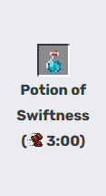
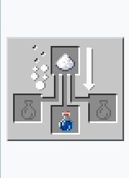


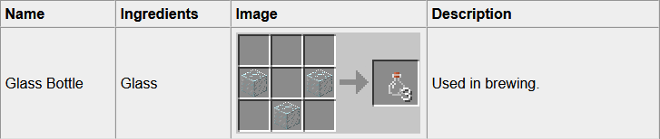


III. How LRLL works?
Outcome
Brewing
Crafting
Killing
Farming/Harvesting
Images from https://minecraft.fandom.com/wiki/Minecraft_Wiki and https://www.minecraftcrafting.info/

Slide 9
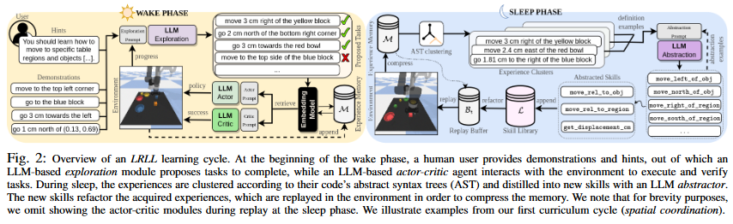


III. How LRLL works?
Lifelong Robot Library Learning or LRLL
Image taken from figure 2 from Tziafas and Kasaei
Wake-Sleep Cycle
Wake: agents interact with environment and users to grow experience
Sleep: agent reflects on experience to expand capabilities
Image from https://www.flaticon.com/free-icon/wake-up_760644 and https://www.freepik.com/icon/enough-sleep_6807803
Notes:
Basic high level idea of what each phase does

Slide 10
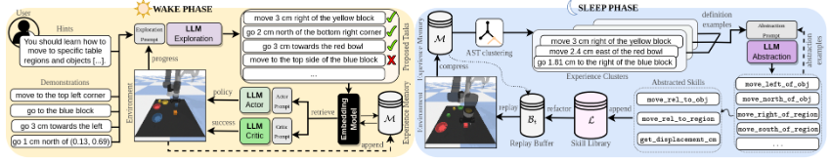
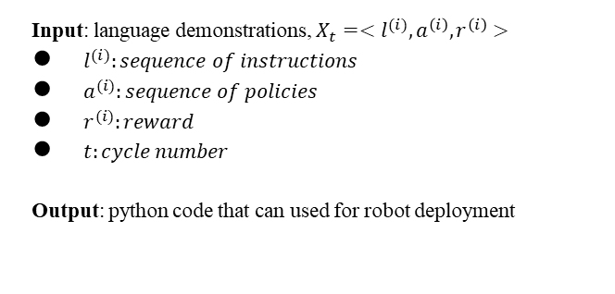
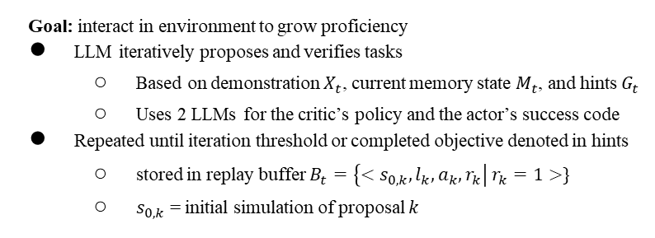
III. How LRLL works?
Input: language demonstrations, $X_{t}=<l^{(i)}, a^{\left(i\right)}, r^{\left(i\right)}>$
$l^{(i)}:sequence of instructions$
$a^{(i)}:sequence of policies$
$r^{(i)}:reward$
$t:cycle number$
Output: python code that can used for robot deployment
Goal: interact in environment to grow proficiency
LLM iteratively proposes and verifies tasks
Based on demonstration $X_{t}$, current memory state $M_{t}$, and hints $G_{t}$
Uses 2 LLMs for the critic’s policy and the actor’s success code
Repeated until iteration threshold or completed objective denoted in hints
stored in replay buffer $B_{t}=\left\{<s_{0,k}, l_{k}, a_{k}, r_{k}\right| r_{k}=1>\}$
$s_{0,k}$ = initial simulation of proposal $k$
Notes:
Demos appended to memory
“a” is factorized based on current library skills
“r” way to verify success
Output: python functions
Notation
a => factorized based on current skill library
r => success code
l => instruction
LLM iteratively proposes task and pushes to simulator
Executed and verified using another LLM’s generated policy and success code
If successful, push to memory
Task
Variations: alter concepts present in instruction
Compositions: combinations of concepts present in demos
Entire process repeated until iteration threshold or objectives are complete
Query which is essentially a task grabs appropriate experience from memory using embedding model
j

Slide 11
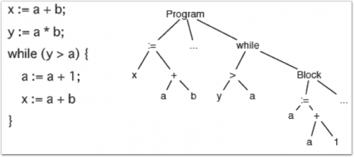
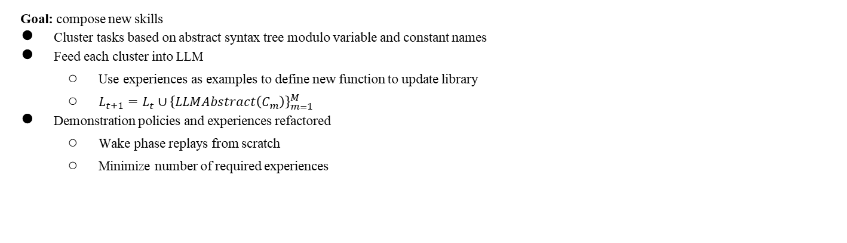
III. How LRLL works?
Goal: compose new skills
Cluster tasks based on abstract syntax tree modulo variable and constant names
Feed each cluster into LLM
Use experiences as examples to define new function to update library
$L_{t+1}=L_{t}∪{\left\{LLMAbstract\left(C_{m}\right)\right\}}_{m=1}^{M}$
Demonstration policies and experiences refactored
Wake phase replays from scratch
Minimize number of required experiences
Image from https://medium.com/hootsuite-engineering/static-analysis-using-asts-ebcd170c955e
Abstract Syntax Tree
Notes:
First created using an abstract syntax tree of policy code
Clustered
Same tree structure modulo variable
Constant names
Clusters fed into LLM => examples in order to define new function to update the library; L_{t+1} = L_t union (LLAbstract of cluster)
Maintain logic but account for variations
Extract boilerplates snippets and abstract into functions
Skills refactor/refine the experiences (set of tasks) and the demo
If previous task fails => refactored and appended into memory
f

Slide 12
III. How LRLL works?
Zero-shot vision-language grounding
CLIP => open vocabulary
MDETR => expression grounding
Most basic primitives
Move arm to certain pose
Opening/closing gripper
To retrieve experience
Uses a query q and top-k most similar experiences
Agent skill corresponds to python function
Replay buffer holds only explored experience of current cycle
Resets at beginning of cycle
Notes:
Frozen pretrained vision-language model: CLIP and MDETR
Experiences reflected as instruction-action-success tuple
Indexed by instruction embedding
Queries are tasks
Query instruction embedded by same model z_q and experience top-k
Skill Library
Replay Buffer
Same as experience memory but only for explored experiences
Exploration
Proposes next task to complete in the simulator
Introduce task variation: alter concepts present in simulator; task compositions: combinations of concepts present in the demos
Skill Abstraction
Maintain same logic code + abstract code variations
Boilerplates => new functions
Prompt
General purpose
API field
Two exemplar function definitions

Slide 13
IV. Experimental Results

Slide 14
IV. Experimental Results
Goals
Compare against baselines for tabletop simulation
Evaluate impact of contributions
Demonstrate transferability from simulation to real life

Slide 15
IV. Experimental Results
GPT-3.5-turbo for vision, text-embedding-ada-002 for memory embedding, and LangChain for LLM’s and agents
Blocks-and-bowls setup replicated from previous works [15], [34]
41 task templates and 4 curriculums
Spatial coordination: precise motion relative to objects/regions
Visual reasoning: determining attributes, resolving spatial relations and counting/enumerating objects
Object manipulation: single picking, releasing and placing tasks
Rearrangement: long-horizon tasks that involve multiple objects and destinations
Task instances
Seen instructions (SI) with seen attributes (SA) or unseen attributes (UA)
Unseen instructions (UI) with unseen attributes (UI)
For lifelong setup
Forward-transfer: unseen combination of tasks
Backward-transfer: contains the forward transformation tasks from previous cycles
Baselines
CLIPort
LLM-static: LLMs provided with static/hand-crafted prompts
LLRL-no-sleep
LLRL-no-wake
Notes:
FT: unseen compositions of tasks
Test whether agent can learn to transfer knowledge between tasks
BT: FT tasks from previous cycle
Note that authors denote seen instructions with seen attributes as (SA), UA for unseen attributes, and UI for unseen instructions and attributes
Test the extent that the agent forgets or improves upon a given task

Slide 16
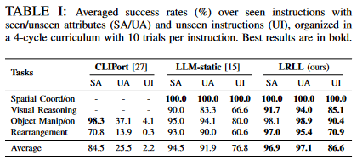
IV. Experimental Results
Tabletop Simulation
Image taken from Table I of paper
LRLL performed the best
CLIPort struggles with unseen attributes
LLM-Static produces non-executable code with unseen instructions at later cycles
LLM-static is robust to unseen attributes
Notes:
CLIPort struggles with unseen attributes
Performance degrades with unseen instructions
LLM-Static (CAP): robust to unseen attributes; generalize well with unseen instructions; produces non-executable code with unseen instructions at later cycles

Slide 17
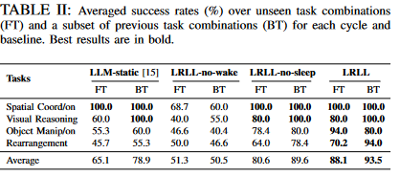
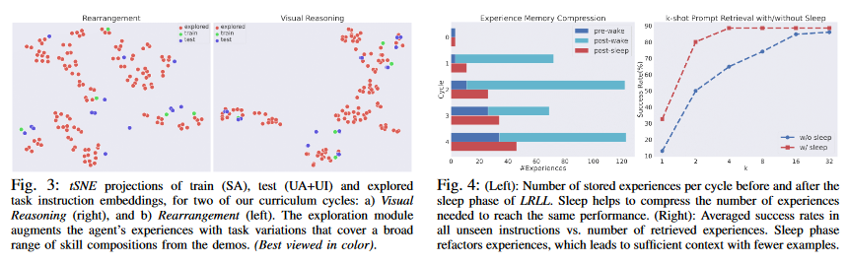
IV. Experimental Results
Ablation
Image taken from Table 2 of paper
Image taken from figures 3 and 4
Notes:
Ablation: study of effect of each proposed component
FT/BT
Table II: all baselines are robust in tasks
No increase in backward task’s performance
FT: LLM-static and LRLL => increase in average success
LRLL-no-sleep => better compositional abilities
Static Prompts vs Retrieval
Later cycles for prompt saturation => hurt LLM; retrieval based baselines ensure fixed context length
Effect of Exploration
Figure 3: LLRL-no-wake struggled across cycles; due to one-one mapping between task and skill
Effect of Abstraction
LLRL-no-sleep never learns new skills
LLRL with sleep: less RAM because less experience
No axis because it uses tSNE just to show variation
LLM and Embedding Models
Zero-shot sim-to-real
Errors were due to collisions and CLIP misclassification

Slide 18
V. Strengths and Weaknesses

Slide 19
V. Strengths and Weaknesses
Strengths
Weaknesses
Memory efficient
Good at learning new skills
Minimal expert intervention
Scalability
Limited by choice of vision API
Limited scalability to skills that can be expressed symbolically
Refining initial prompts to exploration/abstraction modules when changing domains or LLM engines
Latency and price

Slide 20
VI. Extensions

Slide 21
VI. Extensions
Authors want investigate gap between GPT and other alternatives
What applications could LRLL have in a more complicated end-effector such as a humanoid hand?
An LRLL that can learn from visual data?

Slide 22
VII. Appendix

Slide 23
VII. Appendix
Tabletop Simulation Details
Tabletop Manipulation
Simulated teacher
Generated 5 demonstrations
1 per seen attribute
Multiple test for each cycle
10 per unseen attributes and unseen attributes with unseen instructions
CLIPort
1k trajectories per task
LLM-static
Demos append to prompt

